Slide 1
Retail Recommendation Model
Teradata Vantage PoC
Next Best Offer – Recommending next best products to customers based on their past purchase history and behavior
April 2019

Slide 2
Agenda
Objective of POC
Use case Description
Data Quality & Pre-processing
Analysis & Insights
Recommendation (cFilter, pSALSA & CoFactor)

Slide 3
Objective & Values of PoC
Use Case Objective -
Using Historical Transaction data to understand customer behaviour, Customer similarity & Product Similarity and Making Next Best recommendation based on above insights.
Values of doing Advanced Analytics using Teradata Vantage -
Demonstrate the data preparation and loading of varied data
Highlight Analytical and visualization capabilities
Demonstrate, enterprise level capabilities
Showcase ease of use by using pre-defined functions that are relevant in a Retail context
Showcase easy, production-grade Analytical development processes and it’s relevance in Retail.

Slide 4
Use case Description
Detailed Scope/Analytical Question: Identifying next best offer to Customer based on previous purchase history and current behaviour. Recommendation is to be made at Sub-brand, Department, Category, Sub_Category, Sleeve, Size & product Type level.
Assumptions:
Only offline PoS data was to be used,
Data:
Offline PoS Data –1 month (Aug 2016)
New insights expected:
Individual customer level recommendation
Business value Envisaged:
Increase repeat revenue by targeting individuals through personalized campaigns

Slide 5
Analysis & Insights
Objective / Problem Statement
More precisely define next best action based on profile, behaviour and choice perceived by customers
More targeted offerings
Benefits
Discover patterns as per the transactions made by the customer or by profiles of similar customers and make a recommendation in a form of a list of customers ranked by score of the next best offer services.
List of customers in each segment of different usage behaviour or interests.
Work Undertaken
Analyze POS data
Segment customers depending on their interactions with the store (Segmented using RFM -Recency, Frequency, Monetary attributes)
Recommendation is made at Department, Category, Sub Category, Sleeve, Size & Product Type level.
cFilter -Analysts use collaborative filtering to find items or events that are frequently paired with other items or events. For example, an online store that tells a shopper, “Other shoppers who bought this item also bought these items” uses a collaborative filtering algorithm.
pSALSA-pSALSA look for similar customers and makes recommendations by finding a set of customers similar to the specific customer, looks at what else the similar
customers have purchased, and makes recommendations based on that.
Analytics Techniques
Automatic predictions (CFilter methodology) about the interests of a customer by collecting and analyzing preferences (collaborating)
Kmeans technique to perform cluster analysis on numeric and categorical variables to group customers with the similar need.
Automatic predictions (pSalsa methodology) about the interests of similar customers by analyzing preferences

Slide 6
Data Quality & Pre-Processing
Observations:
Following attributes from PoS records were selected for analysis:
Bill number, Bill Date, Store id, Customer id, Sub-brand, Department, Category, Sub Category, Sleeve, Size, Product Type, Quantity & Selling price.
Total number of PoS records provided: 45492
Initially, the Data was loaded in AS-IS form, and later it was cleaned as described in the last slide From analytical and recommendation perspective, 7 key attributes were selected from PoS data
Customer Id
Sub Brand
Department
Category
Sub Category
Sleeve
Size Product Type
These 7 attributes were concatenated into one string and was used as a parameter for visualizing output.

Slide 7
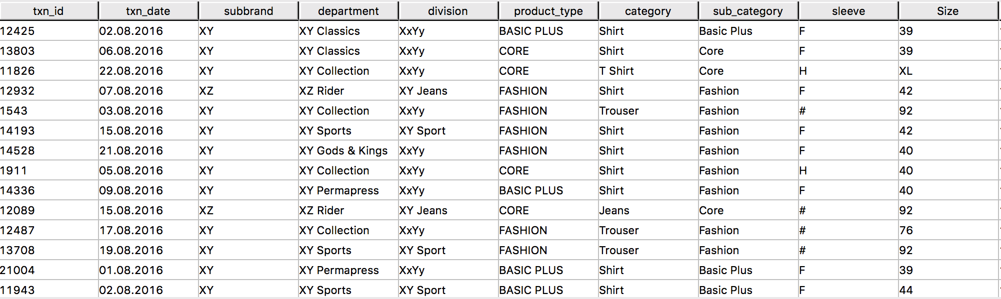
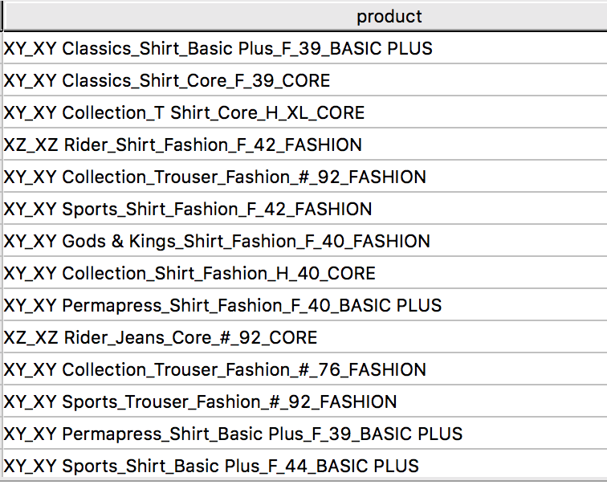
Data Quality & Pre-Processing
Raw Data
Derived Product Column

Slide 8
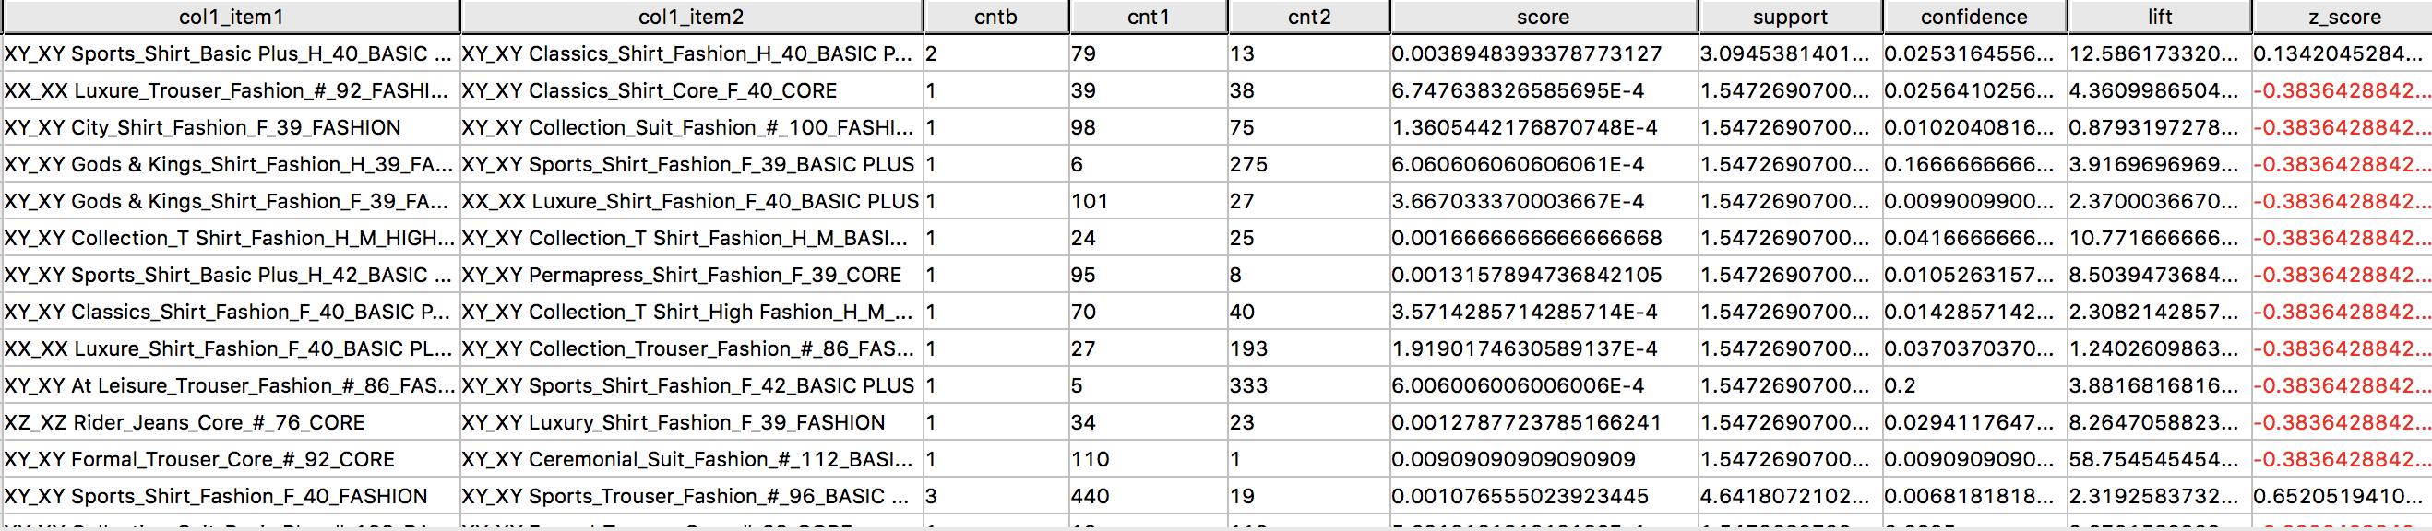
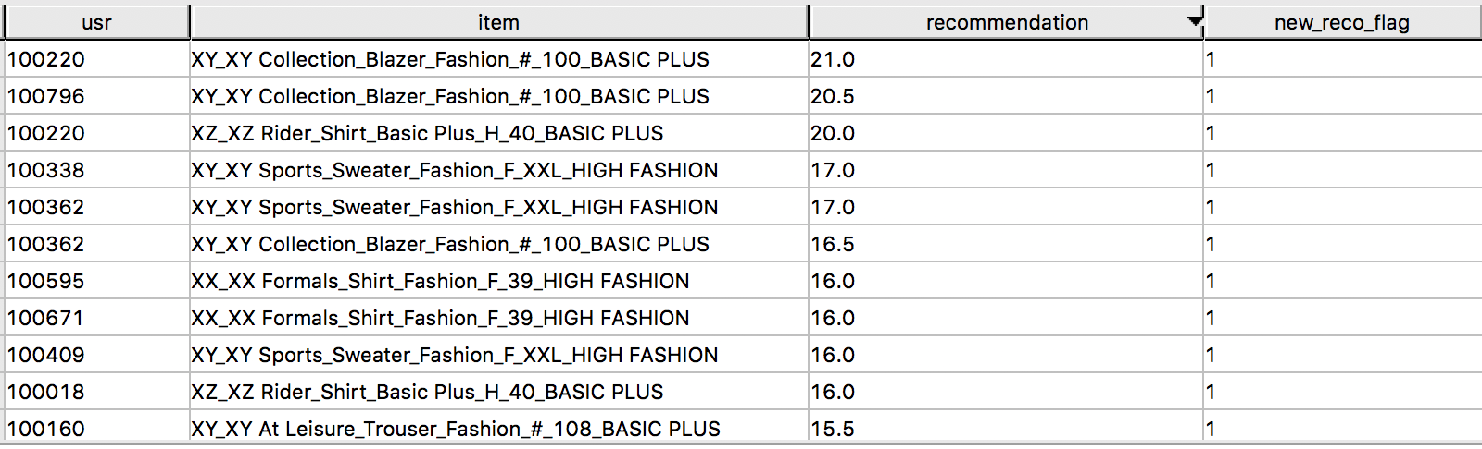
Model -1 : cFilter - Recommendation Results
cFilter gives list of similar items along with many important similarity metrics as given below :
Recommendation provided at 7 selected levels along with Recommendation Score and New Recommendation Flag (using WSRecommender)

Slide 9
Analysis & Insights – using AppCenter
Vantage provides a simple SQL implementation of cFilter and pSALSA algorithms. The cleaned PoS Data was run against both these algorithms.
The analyses showed that most frequently bought item was carry bag (Fig 1). After consulting, it was decided to remove PoS records with Carry bag as a line item.
The model was run again, and this time the analyses showed some accessories as most significant items (Fig 2). Subsequently it was decided to remove Accessories from the Analyses.
The model was run for the third time with only “main” items. This time it showed correlation between Shirts, and Trousers and fit apparel preference etc. (Fig 3).
cFilter recommender was run each time, and with each run, the model improved.

Slide 10
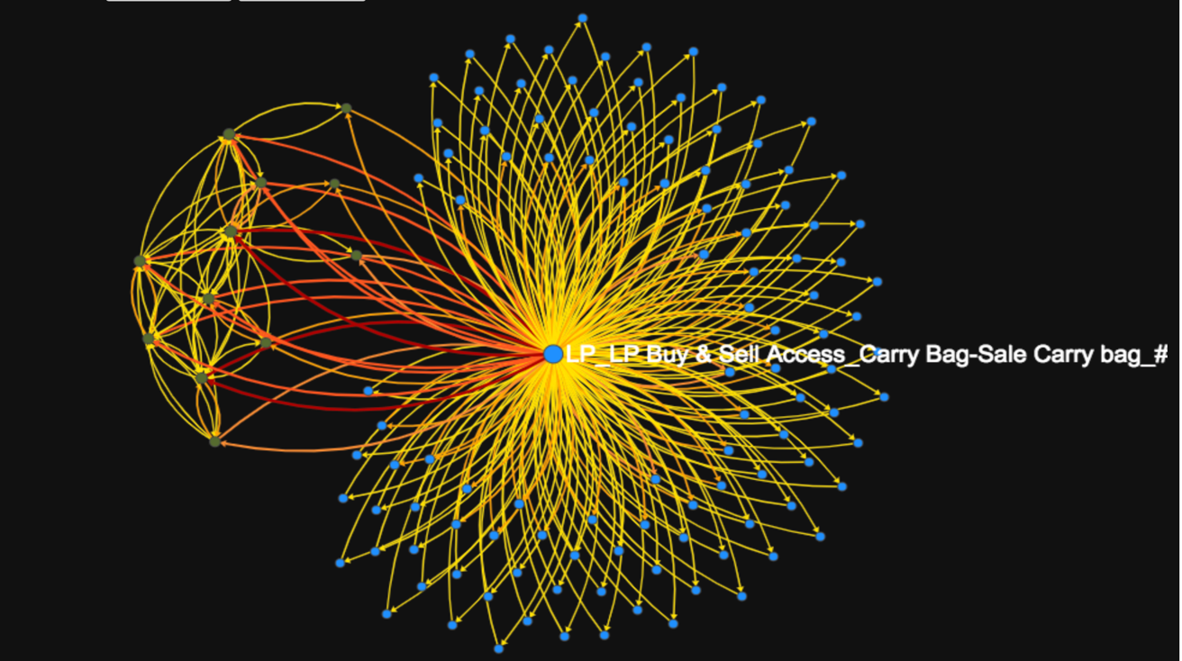
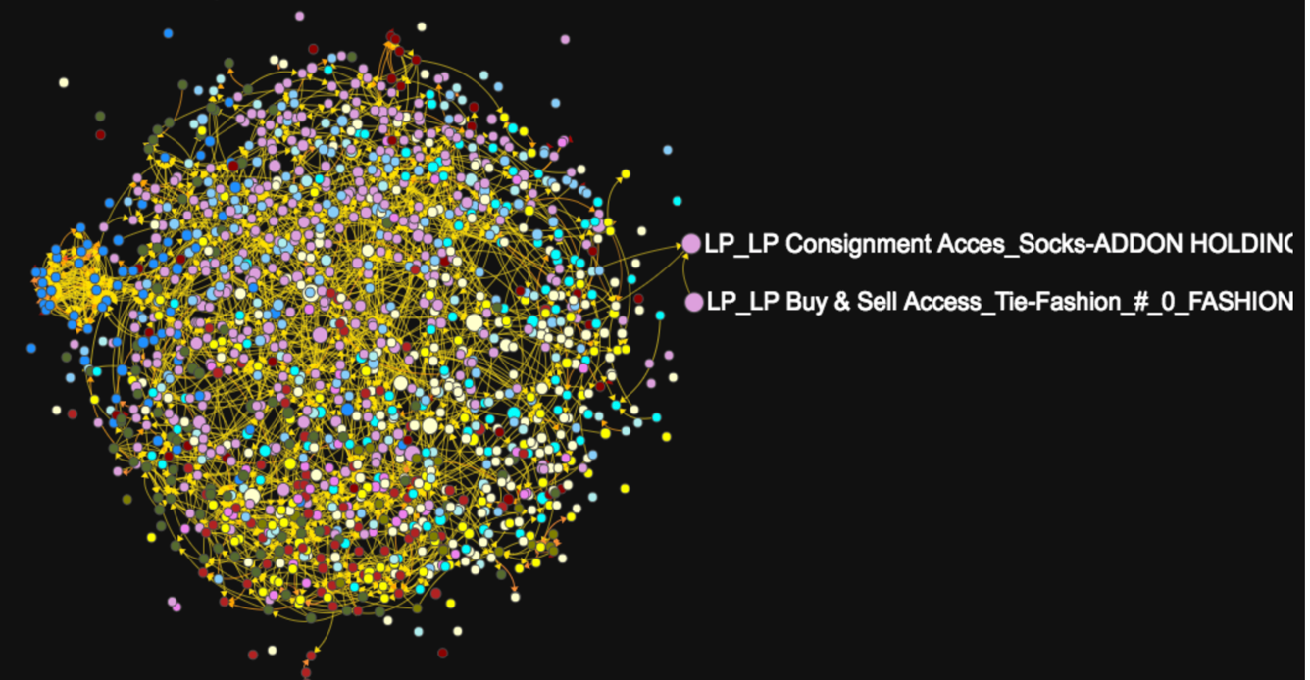
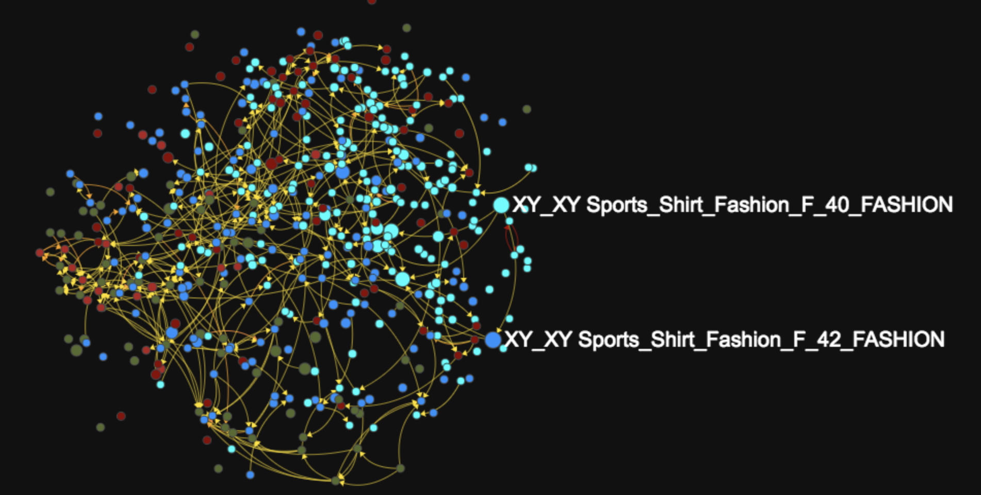
Analysis & Insights – cFilter Product Affinity Charts
Product Affinity with Carry bag showing that carry bag was bought with most of the items
Product Affinity with Carry bag removed but with accessories showing that Socks & Tie have strong affinity with formal wear.
Sigma chart showing affinity between main line items after removing carry bags and accessories from the Analysis.

Slide 11
Recommendation Validation Approach
Total Data set was split into 2 sets –Training set : 3 weeks and Validation set 1 week
cFilter model and WSRecommender were run on Training set
Customers who had made purchase in last week were identified. Some these customers had also made purchase before last week thereby PoS records for these customers were in both Training and Validation sets
cFilter Recommendation was compared with actual purchases on the 7 parameters listed in the last slide
Top 10 recommendations for each customer were considered
Recommendation Accuracy Evaluation using Average Recall

Slide 12
cFilter Recommendation – Predicted Vs. Actual
Recommendations for Customer - 100471
Validation (Actual Purchases) for Customer - 100471
XY_XY Classics_Shirt_Basic Plus_F_48_BASIC PLUS
XY_XY Collection_Trouser_Fashion_#_92_BASIC PLUS
XY_XY Permapress_Shirt_Fashion_F_50_BASIC PLUS
XZ_XZ Rider_T Shirt_High Fashion_H_XXL_HIGH FASHION
Purchase date - 24.08.2016
XY_XY Classics_Shirt_Basic Plus_F_39_BASIC PLUS
XY_XY Classics_Shirt_Basic Plus_F_40_BASIC PLUS
XY_XY Permapress_Shirt_Fashion_F_46_BASIC PLUS
XY_XY Permapress_Shirt_Fashion_F_46_BASIC PLUS
Purchase date - 25.08.2016
XY_XY Classics_Shirt_Basic Plus_F_42_BASIC PLUS
XY_XY Permapress_Shirt_Fashion_F_40_BASIC PLUS
Purchase date - 27.08.2016
XY_XY Classics_Shirt_Basic Plus_F_39_BASIC PLUS
XY_XY Classics_Shirt_Basic Plus_F_42_BASIC PLUS
Purchase date - 28.08.2016
XY_XY Classics_Shirt_Basic Plus_F_40_BASIC PLUS
XY_XY Classics_Shirt_Basic Plus_F_42_BASIC PLUS
XZ_XZ Rider_T Shirt_High Fashion_H_XL_HIGH FASHION
XY_XY Collection_Trouser_Fashion_#_76_BASIC PLUS

Slide 13
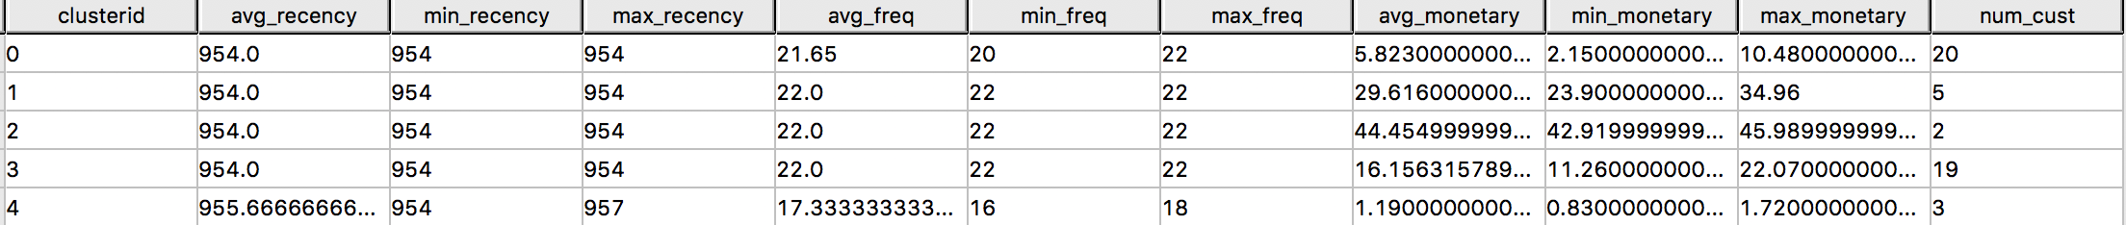
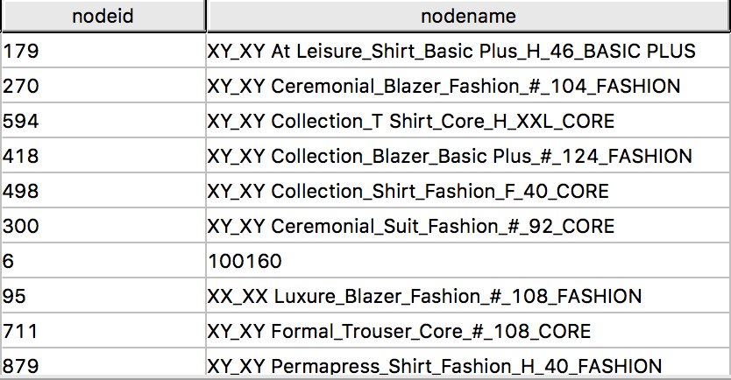
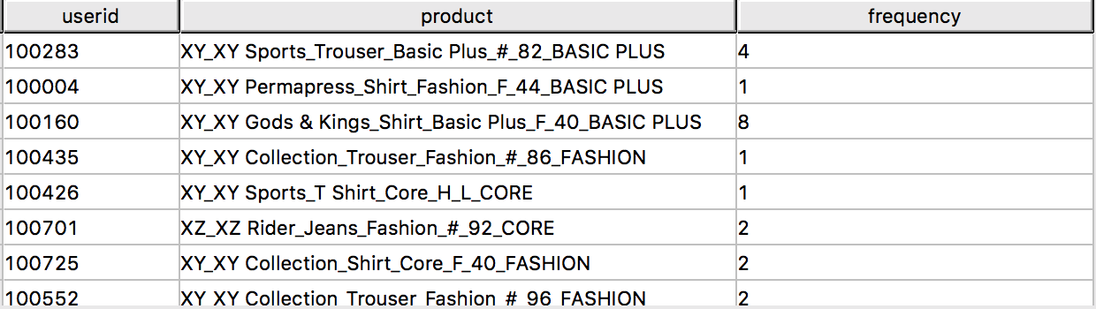
Model -2 : pSALSA - Recommendation Results Segmentation -> pSALSA
Clustering - Using RFM
pSALSA input – Vertices and Edges Data

Slide 14
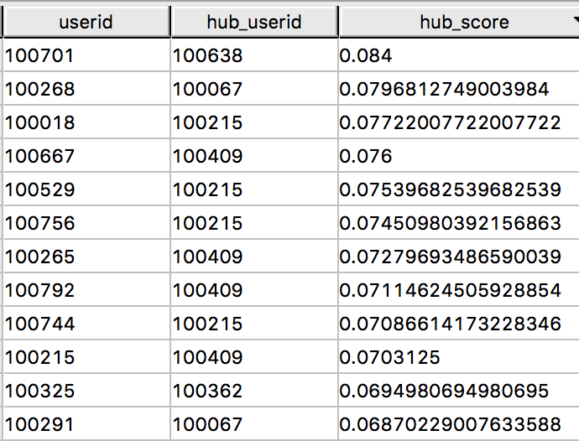
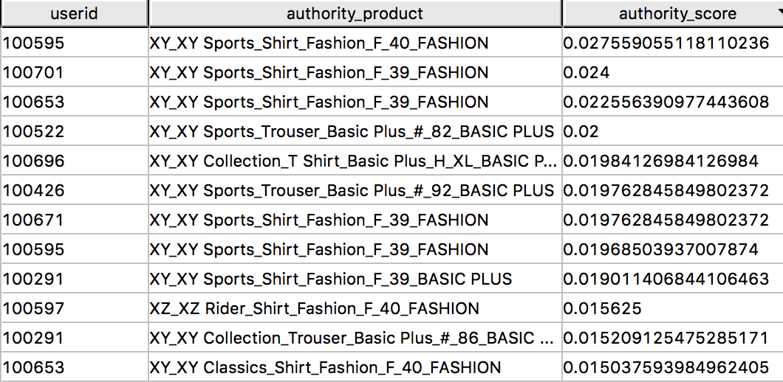
Model -2 : pSALSA - Recommendation Results
User – User Connection
Product Recommendation

Slide 15
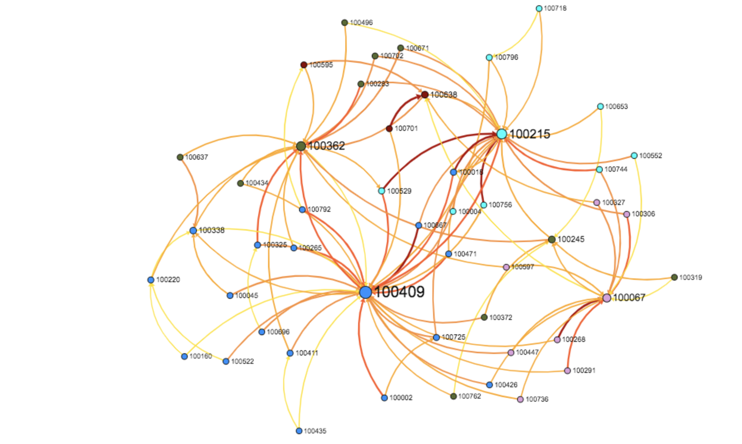
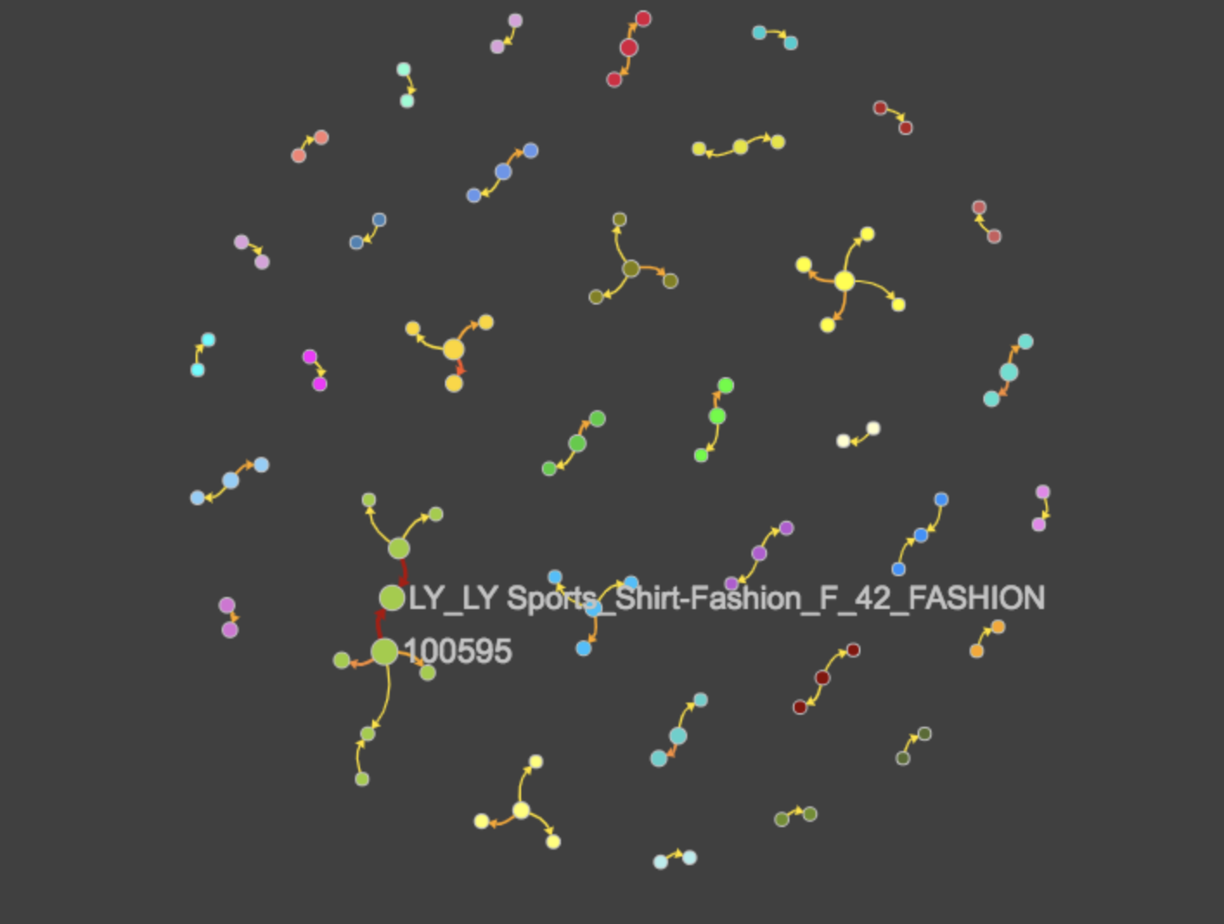
Analysis & Insights – pSALSA
User – User Affinity Analysis (1) & User – Product Recommendation Analysis(2)

Slide 16
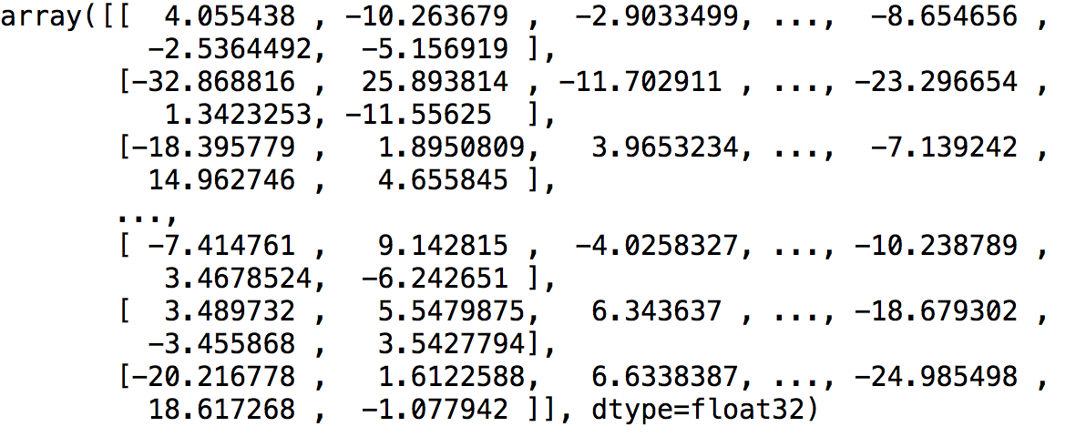
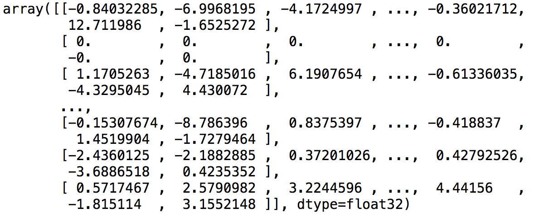
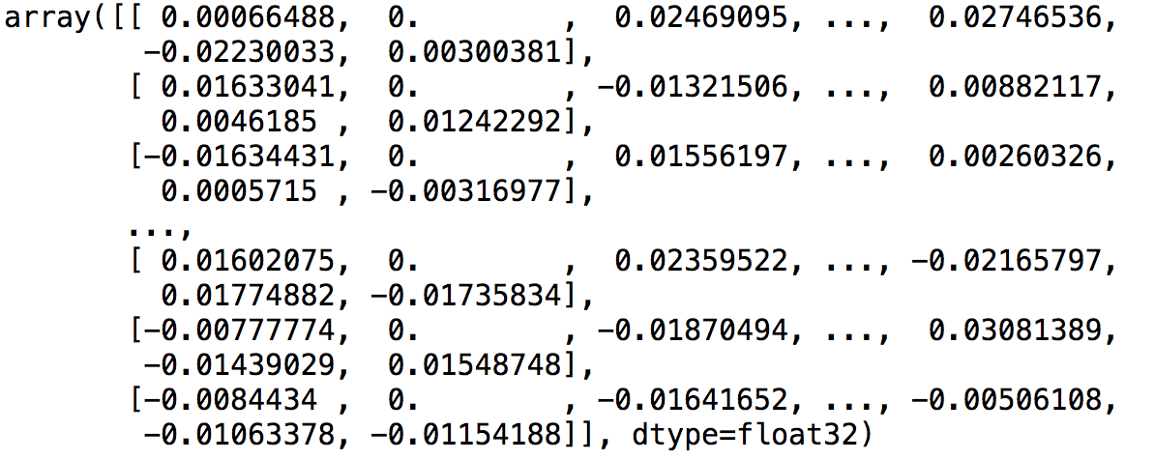
Model -3 : Matrix Factorization(CoFactor) - Recommendation Results
User-latent factor matrix (49x50)
Item-latent factor matrix (1236x50)
Recommendation matrix (49x1236)

Slide 17
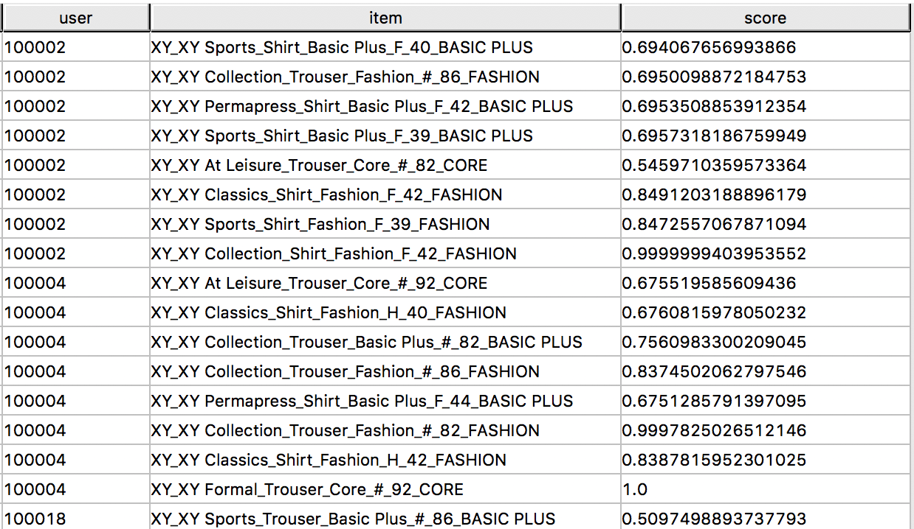
Model -3 : Matrix Factorization(CoFactor) - Recommendation Results
Product Recommendation

Slide 18
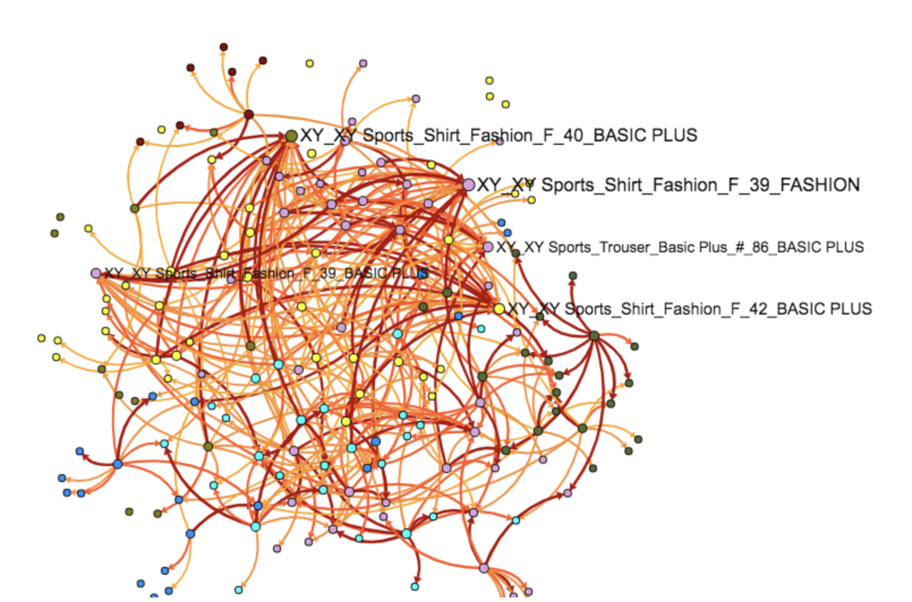
Analysis & Insights – CoFactor : User-Product Recommendation Analysis

Slide 19
Recommendation Accuracy – Average Recall@10
 | Department Category Sub category Sleeve Product Type | Department Category Sub category Product Type | Department Category Sub category | Department Category | Department | Category
cFilter | 0.018833257 | 0.034330554 | 0.079297821 | 0.219026549 | 0.482965932 | 0.556390977
pSALSA | 0.005512173 | 0.005885238 | 0.011501211 | 0.030973451 | 0.064128257 | 0.142857143
CoFactor | 0.125401929 | 0.134870034 | 0.154358354 | 0.241150442 | 0.346693387 | 0.45112782

